Slide 1


Sentiment Analysis with Machine Learning
By Collin Loo

Slide 2




What Is Sentiment Analysis
Stains chalkboard, if you intend on using it again do not use these Don’t buy

Slide 3

Objectives
Business Case
Classify reviews to identify product weaknesses
Approach
Develop two machine learning models:
Support-Vector Machine
Neural Network

Slide 4

Obtain Data
Data Source
https://nijianmo.github.io/amazon/index.html
Model Data Summary
20 office
products
134,677
reviews
3,000 or more reviews per product

Slide 5

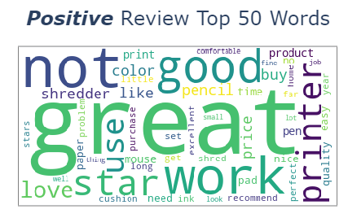
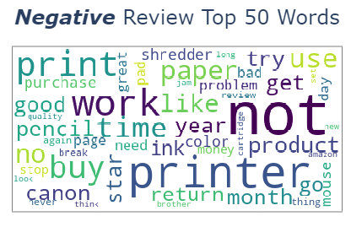
Data Exploration, Word Cloud
Bigger font = more frequent words
Quick insight into unstructured texts

Slide 6
Text Processing
< >
IS, PUT...
,#!…
1,2,3…
HTML Tags
Stop
Words
Punctuations
Digits
A, I …
‘ ‘
Was = Is
Single
Letter
Spaces
Lemmatization

Slide 7

Model A, Support-Vector Machine
Train & Test Data
Text to Matrix
Grid Search
Train Model
Evaluation

Slide 8
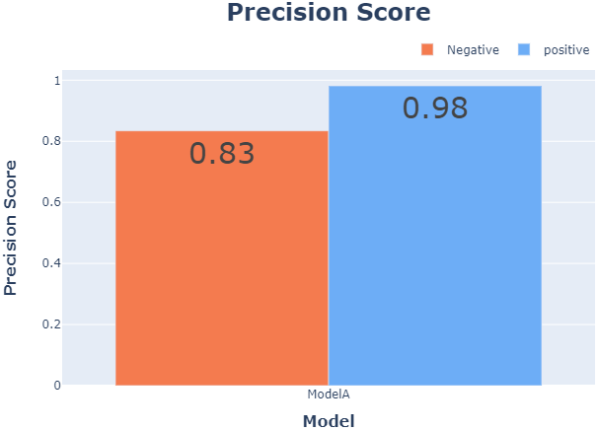
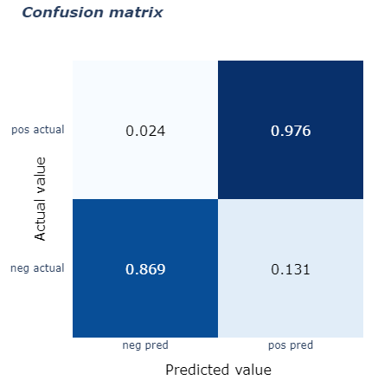
Model A, Performance Results

Slide 9
Model B, Neural Network
Train & Test Data
Embedded Layer with GloVe
Neural Network
Train Model
Evaluation

Slide 10
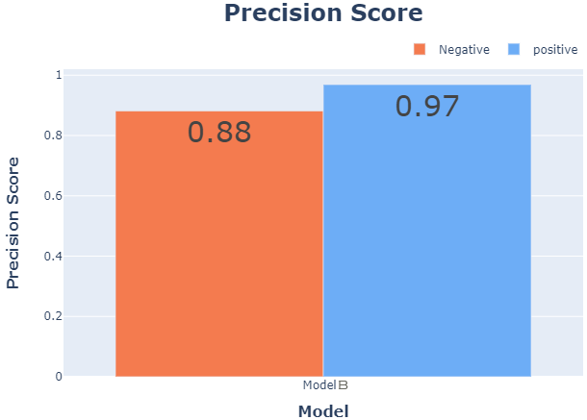
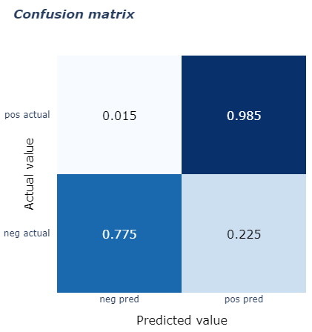
Model B, Performance Results

Slide 11
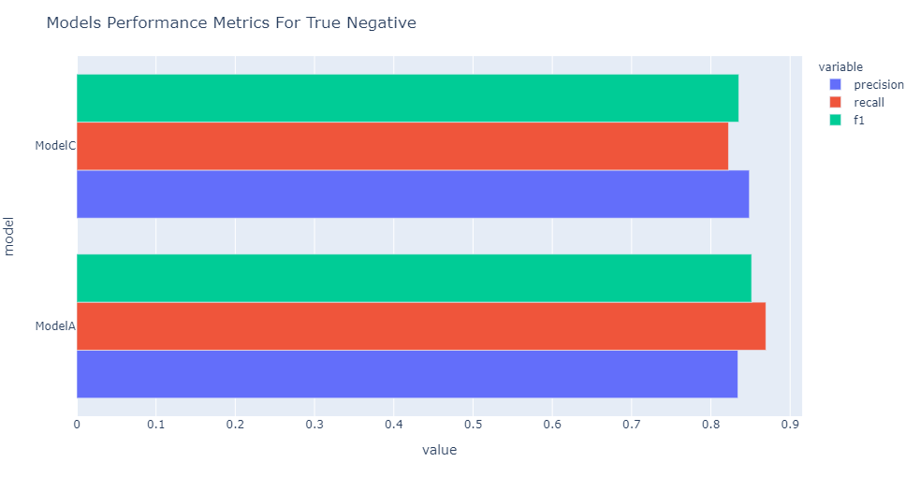
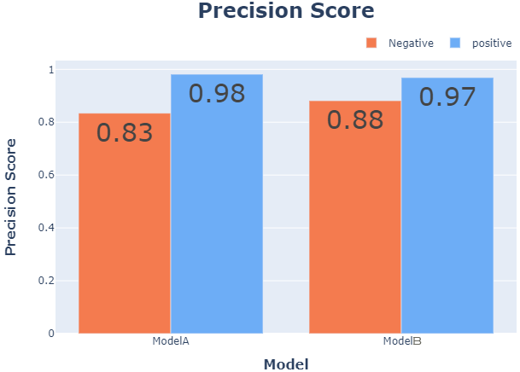
Model Comparison – True Negative

Slide 12

Model Comparison – True Positive

Slide 13
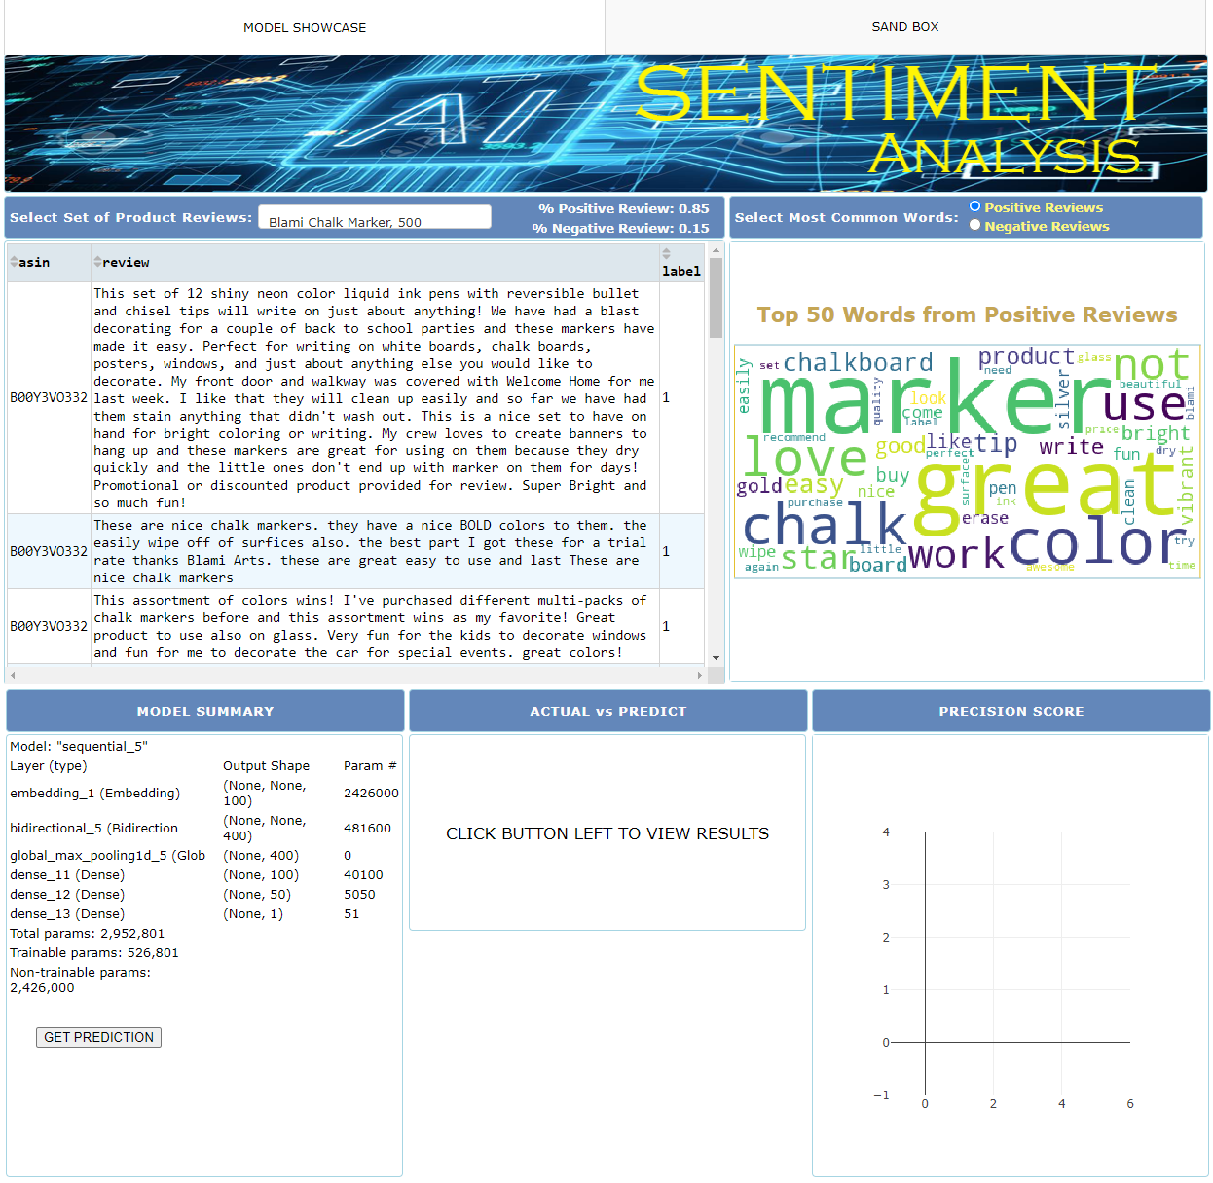
Dash Application
Data, Word Cloud
Data Prediction

Slide 14
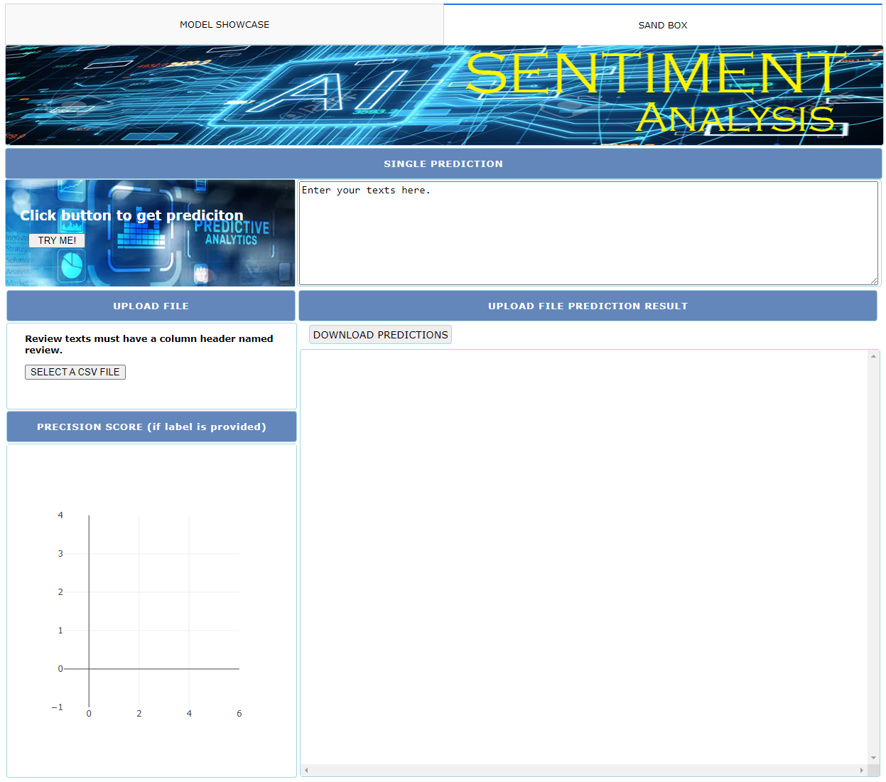
Dash Application
Texts Prediction
Upload Download

Slide 15




Recommendation
Customer
Service
Market
Research
Social
Media
Monitoring
Product
Analytics

Slide 16
Conclusion
Short time to train
Simple Neural Network
79% to 86% True Negative and 97 % True Positive F1-Score on new data

Slide 17
Future Work
Alternate Supervised Learning
Google Word2Vec
Word Vector Dimension
Hidden Layers

Slide 18



Thank You
Change things
At Flatiron School you learn how the future is being built, so you can change anything, starting with a new career in code, data science, or cybersecurity
Collin Loo
collinloo@yahoo.com
www.linkedin.com/in/collin-loo

